Slide 1
Natural Language Processing
Sentence Embedding

Slide 2
Outline
Introduction
Simple Explanation of RNN
Skip-Thought Vectors
Sent2vec
Practical tasks ideas:
Short Answer Grading
Essay Scoring
Question Answering

Slide 3
Introduction
Sentence embedding is the collective name for a set of techniques in natural language processing (NLP) where sentences are mapped to vectors of real numbers.
Popular embeddings are based on the hidden layer outputs of transformer models like BERT(SBERT).
An alternative direction is to aggregate word embeddings, such those returned by Word2vec, into sentence embeddings.
The most straightforward approach is to simply compute the sum or average of word vectors, known as continuous bag-of-words (CBOW).

Slide 4
Introduction
vec(“dog”) = (0.2, -0.3, 1.5,…)
vec(“bites”) = (0.5, 1.0, -0.4,…)
vec(“man”) = (-0.1, 2.3, -1.5,…)
Sum: vec(“dog bites man”) = (0.6, 3.0, -0.4,…)
Avg: vec(“dog bites man”) = (0.2,1.0, -0.133,…)
Clearly there is a lot missing from these representations:
“man bites dog” = “dog bites man”
“the quick, brown fox jumps over the lazy dog” = “the lazy fox over the brown dog jumps quick”

Slide 5
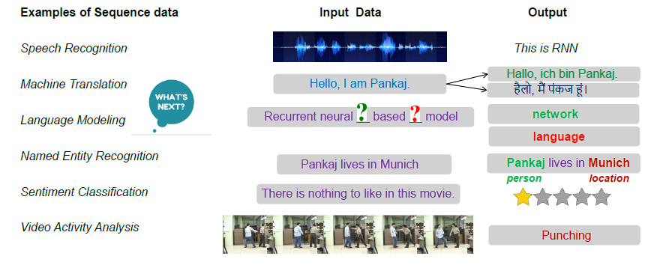
Recurrent Neural Network (RNN)
Motivation: Need for Sequential Modeling

Slide 6
Recurrent Neural Network (RNN)
A recurrent neural network (RNN) is a neural network that is specialized for processing a sequence of data x(t)= x(1), . . . , x(τ) with the time step index t ranging from 1 to τ.
RNNs are called recurrent because they perform the same task for every element of a sequence, with the output being depended on the previous computations.
Another way to think about RNNs is that they have a “memory” which captures information about what has been calculated so far.

Slide 7
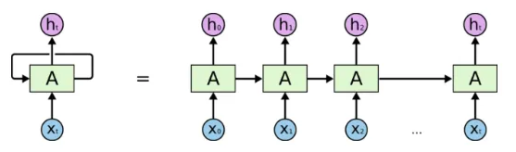
Recurrent Neural Network (RNN)
First, it takes the X(0) from the sequence of input and then it outputs h(0) which together with X(1) is the input for the next step.
So, the h(0) and X(1) is the input for the next step.
Similarly, h(1) from the next is the input with X(2) for the next step and so on.
This way, it keeps remembering the context while training.

Slide 8
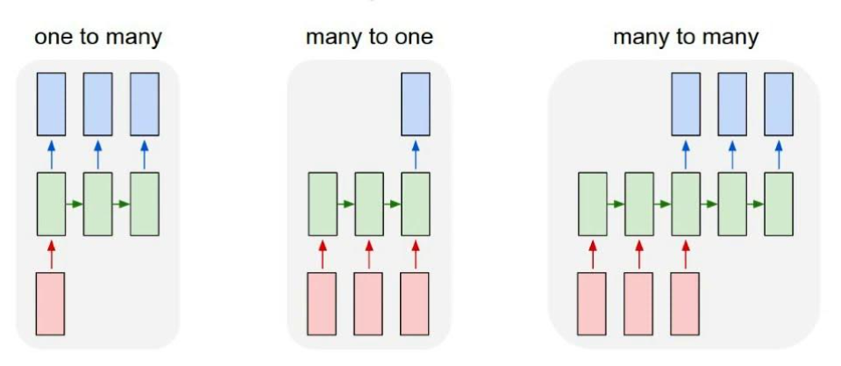
Recurrent Neural Network (RNN)
Types of sequence tasks:

Slide 9
Recurrent Neural Network (RNN)
One-to-Many: It deals with a fixed size of information as input that gives a sequence of data as output.
Example: Image Captioning takes the image as input and outputs a sentence of words.
Many-to-One: It takes a sequence of information as input and outputs a fixed size of the output.
Example: Sentiment analysis where any sentence is classified as expressing the positive or negative sentiment.
Many-to-Many: It takes a Sequence of information as input and processes the recurrently outputs as a Sequence of data.
Example: Machine Translation, where the RNN reads any sentence in English and then outputs the sentence in French.

Slide 10
Recurrent Neural Network (RNN)
There are two major obstacles RNNs have had to deal with, but to understand them, you first need to know what a gradient is.
A gradient is a partial derivative with respect to its inputs.
If you don’t know what that means, just think of it like this: a gradient measures how much the output of a function changes if you change the inputs a little bit.
You can also think of a gradient as the slope of a function.
The higher the gradient, the steeper the slope and the faster a model can learn.
But if the slope is zero, the model stops learning.
A gradient simply measures the change in all weights with regard to the change in error.

Slide 11
Recurrent Neural Network (RNN)
EXPLODING GRADIENTS:
Exploding gradients are when the algorithm, without much reason, assigns a stupidly high importance to the weights.
Fortunately, this problem can be easily solved by truncating or squashing the gradients.
VANISHING GRADIENTS
Vanishing gradients occur when the values of a gradient are too small and the model stops learning or takes way too long as a result.
Fortunately, it was solved through the concept of LSTM .

Slide 12
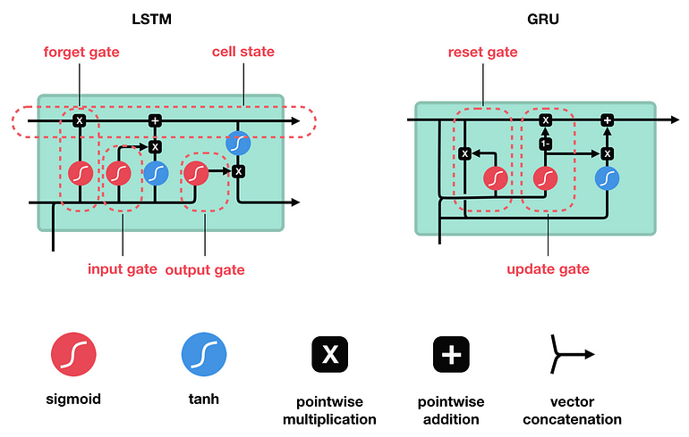
Recurrent Neural Network (RNN)
Long short-term memory networks (LSTMs) are an extension for RNNs, which basically extends the memory.
Therefore, LSTM is well suited to learn from important experiences that have very long time lags in between.
LSTM are used as the building blocks for the layers of a RNN.
In a long short-term memory cell you have three gates: input, forget and output gate.
These gates determine whether or not to let new input in (input gate), delete the information because it isn’t important (forget gate), or let it impact the output at the current timestep (output gate).

Slide 13
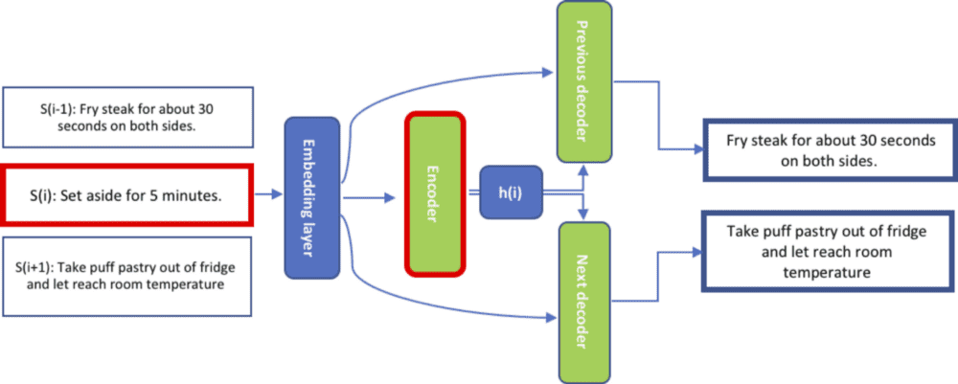
Skip-Thought Vectors
Skip-Thought vectors used word2vec learning as inspiration.
Skip-thought vectors are created using an encoder-decoder model.
The encoder takes in the training sentence and outputs a vector.
There are two decoders both of which take the vector as input.
The first attempts to predict the previous sentence and the second attempts to predict the next sentence.

Slide 14
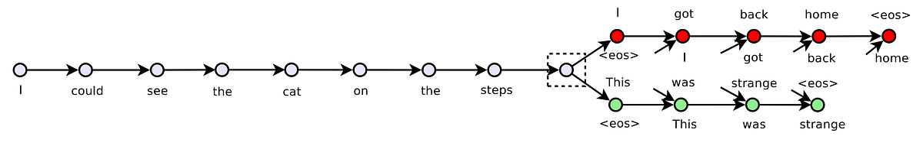
Skip-Thought Vectors
Both the encoder and decoder are constructed from recurrent neural networks (RNN).
Multiple encoder types are tried including uni-skip, bi-skip, and combine-skip.
Uni-skip reads the sentence in the forward direction.
Bi-skip reads the sentence forwards and backwards and concatenates the results.
Combined-skip concatenates the vectors from uni-skip and bi-skip (Size= 4800).
Only minimal tokenization is done to the input sentences.

Slide 15
Skip-Thought Vectors
The model requires groups of sentences in order to train, and so trained on the BookCorpus Dataset.
8 tasks were considered:
Semantic-Relatedness
Paraphrase Detection
Image sentence ranking
5 standard classification benchmarks
Kiros, R., Zhu, Y., Salakhutdinov, R. R., Zemel, R., Urtasun, R., Torralba, A., & Fidler, S. (2015). Skip-thought vectors. Advances in neural information processing systems, 28.

Slide 16
Skip-Thought Vectors (Semantic-Relatedness)
Given two sentences, our goal is to produce a score of how semantically related these sentences are, based on human generated scores.
Each score is the average of 10 different human annotators.
Scores take values between 1 and 5.
A score of 1 indicates that the sentence pair is not at all related, while a score of 5 indicates they are highly related.
The SICK dataset comes with a predefined split of 4500 training pairs, 500 development pairs and 4927 testing pairs.
Pearson’s Correlation 0.86.
Notes:
The Sentences Involving Compositional Knowledge (SICK) dataset

Slide 17
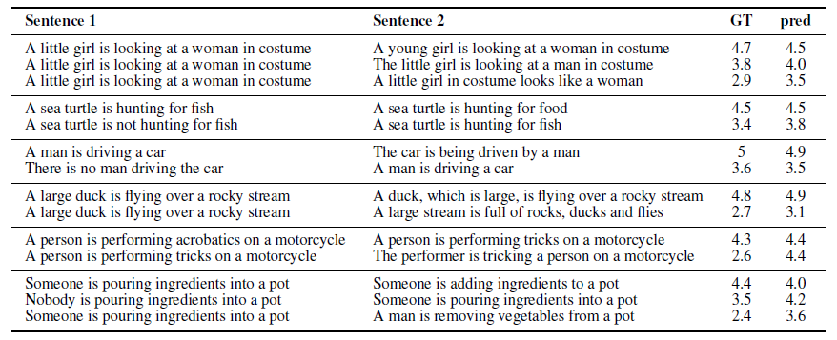
Skip-Thought Vectors (Semantic-Relatedness)
Notes:
The Sentences Involving Compositional Knowledge (SICK) dataset

Slide 18
Sent2Vec
Sent2Vec can be seen as an extension of the CBOW training objective to train sentence instead of word embeddings.
Sent2Vec is a simple and fast unsupervised model allowing to compose sentence embeddings using word vectors along with n-gram embeddings.
Surprisingly, for constructing sentence embeddings, naively using averaged word vectors was shown to outperform RNN and LSTMs.
Three different datasets have been used to train Sent2Vec models:
Toronto book corpus (70M sentences)
Wikipedia sentences
Tweets
The Wikipedia and Toronto books sentences have been tokenized using the Stanford NLP library while for tweets we used the NLTK tweets tokenizer.

Slide 19
Sent2Vec
Paper: Unsupervised Learning of Sentence Embeddings using Compositional n-Gram Features
Original Source: https://github.com/epfml/sent2vec
sent2vec_wiki_unigrams 5GB (600dim, trained on english wikipedia)
sent2vec_wiki_bigrams 16GB (700dim, trained on english wikipedia)
sent2vec_twitter_unigrams 13GB (700dim, trained on english tweets)
sent2vec_twitter_bigrams 23GB (700dim, trained on english tweets)
sent2vec_toronto books_unigrams 2GB (700dim, trained on the toronto books dataset)
sent2vec_toronto books_bigrams 7GB (700dim, trained on the toronto books dataset)

Slide 20
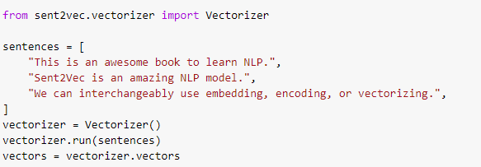

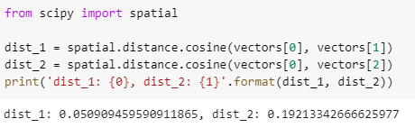
Sent2Vec

Slide 21
Short Answer Grading
The rapidly growing educational community raised the need for Automatic Scoring systems.
Automatic Scoring Benefits:
Reduces Time.
Provides evaluation consistency and standardization.
Handles different types of students’ responses.
Provides useful feedback to students

Slide 22
Short Answer Grading
Automatic Scoring systems are easily implemented for:
Multiple Choice.
True-False.
Matching .
Fill-in-the-Blank.
Implementing an automatic scoring system for questions that require free text answers is more difficult because students’ answers require complicated text understanding and analysis.

Slide 23
Short Answer Grading
Automatic Answer Grading (SAG) system is one which automatically assigns a grade to an answer provided by a student through a comparison with one or more correct answers.
Sample Question
Arabic Text: عرف الهائمات؟ Translated Text: Define Plankton?
Model Answer
Arabic Text: كائنات نباتية أو حيوانية دقيقة الحجم تحملها الأمواج بلا مقاومة نظرا لصغر أجسامها. Translated Text: Small sized plant or animal organisms that are carried by waves without resistance due to their small bodies.

Slide 24
Short Answer Grading
Automatic Answer Grading (SAG) system is one which automatically assigns a grade to an answer provided by a student through a comparison with one or more correct answers.
Students’ Answers | Grades
Student’s Answer No.1 | 5 | 4
Arabic Text: هى كائنات دقيقة مجهرية نباتية أو حيوانية تعيش فى المياه السطحية للبحار تحملها الأمواج بلا مقاومة. Translated Text: Tiny microscopic plant or animal organisms that lives in surface water of seas that are carried by waves without resistance.
Student’s Answer No.2 | 3 | 3
Arabic Text: كائنات تنتشر فى الطبقة السطحية فى البحار و تحملها الأمواج دون مقاومة. Translated Text: Organisms that spread in surface layer of seas and are carried by waves without resistance.

Slide 25
Short Answer Grading
Challenges:
Lack of annotated Datasets
Different levels of semantic similarity are required
Evaluation Biases
Difficulty forming feedback

Slide 26
Short Answer Grading
Short answer grading is addressed as a text similarity problem (between Student’s Answer and Model Answer).
Short Answer contains from one to three sentences.
Similarity values are normalized and scaled to obtain the final automatic score.
Similarity values are used as input features to different Machine and deep learning classifiers.

Slide 27
Short Answer Grading
Types of Text Similarity
Text Similarity
String-Based
Semantic-Based
Corpus-Based
Knowledge-Based
Embedding-Based
Character-Based
Term-Based

Slide 28
Short Answer Grading
Different Techniques
Normalizing and Scaling Similarity Values
ML Models (Regression, Classification, Clustering)
Deep Learning (Neural Networks) Models
Ensemble-Models (Merging Different Models)

Slide 29
Short Answer Grading
Evaluation Metrics
Quadrated weighted kappa
Mean Absolute Error
Pearson Correlation Coefficient
Notes:
The quadratic weighted kappa will find agreement between human evaluation score and system evaluation score and produces value ranging from 0 to 1.
And the Mean Absolute Error is the actual difference between human-rated score to system-generated score. The mean square error (MSE) measures the average squares of the errors, i.e., the average squared difference between the human-rated and the system-generated scores. MSE will always give positive numbers
only.
Pearson’s Correlation Coefficient (PCC) finds the correlation coefficient between
two variables. It will provide three values (0, 1, − 1). "0" represents human-rated and
system scores that are not related. "1" represents an increase in the two scores. "− 1"
illustrates a negative relationship between the two scores.

Slide 30
Essay Scoring
Automated essay scoring (AES) is a computer-based assessment system that automatically scores or grades the student responses by considering appropriate features.
AES is a form of educational assessment and an application of natural language processing (NLP).
Given an essay, our aim is to evaluate it and give:
Qualitative score
Useful Feedback

Slide 31
Essay Scoring
Extracting different types of features based on :
Essay Contents
Essay Organization
Writing Styles
Relevance
Creativity …..
Extracting different types of errors:
Spelling, Grammar, Semantic …..

Slide 32
Essay Scoring
Challenges:
Lack of annotated Datasets
There is no Model Answer
Evaluation Biases
Plagiarism

Slide 33
Essay Scoring
Types of features:
Features
Statistical
Style-Based
Content-Based

Slide 34
Essay Scoring
Types of features:
Samples of Statistical Features
Essay length
Samples of Style-based Features
Word Choice
Samples of Content-Based Features
Cohesion
Relevance of information
Number of sentences
sentence length
Word length
N-grams
Sentence Structure & Syntax
Punctuations & Conjunctions
Part of Speech (POS)
Number of Nouns, Verbs, Adjectives, Adverbs
Number of spelling errors
Semantic Similarity
Coherence
Domain Knowledge
Notes:
Cohesion: appropriate use of transition phrases
Coherence: appropriate transitions between ideas

Slide 35
Essay Scoring
Different Techniques:
ML Regression Models
ML Classification Models
Ontology-Based Models
Deep Learning (Neural Networks) Models

Slide 36
Essay Scoring
Evaluation Metrics:
Quadrated weighted kappa
Mean Absolute Error
Pearson Correlation Coefficient

Slide 37
Question Answering
The QA system is composed of three main modules:
Question Analysis
Passage Retrieval
Answer Extraction
Question
Question Analysis
Passage Retrieval
Answer
Answer Extraction

Slide 38
Question Answering
Question Analysis Module
Syntactic & Semantic Analysis
Question Classification
Question
Preprocessing
Focus & Intent Recognition
Answer Type Recognition

Slide 39
Question Answering
Passage Retrieval Module
Passage Retrieval Module
Passage Retrieval Module
Document Corpus
Candidate Document Retrieval
Candidate Passage Extraction
Candidate Passage Ranking
Indexing
Knowledge Base

Slide 40
Question Answering
Answer Extraction Module
Answer Extraction Module
Candidate Answers Extraction
Candidate Answers Ranking
Answer Generation
Answer Validation

Slide 41


